Slide 1
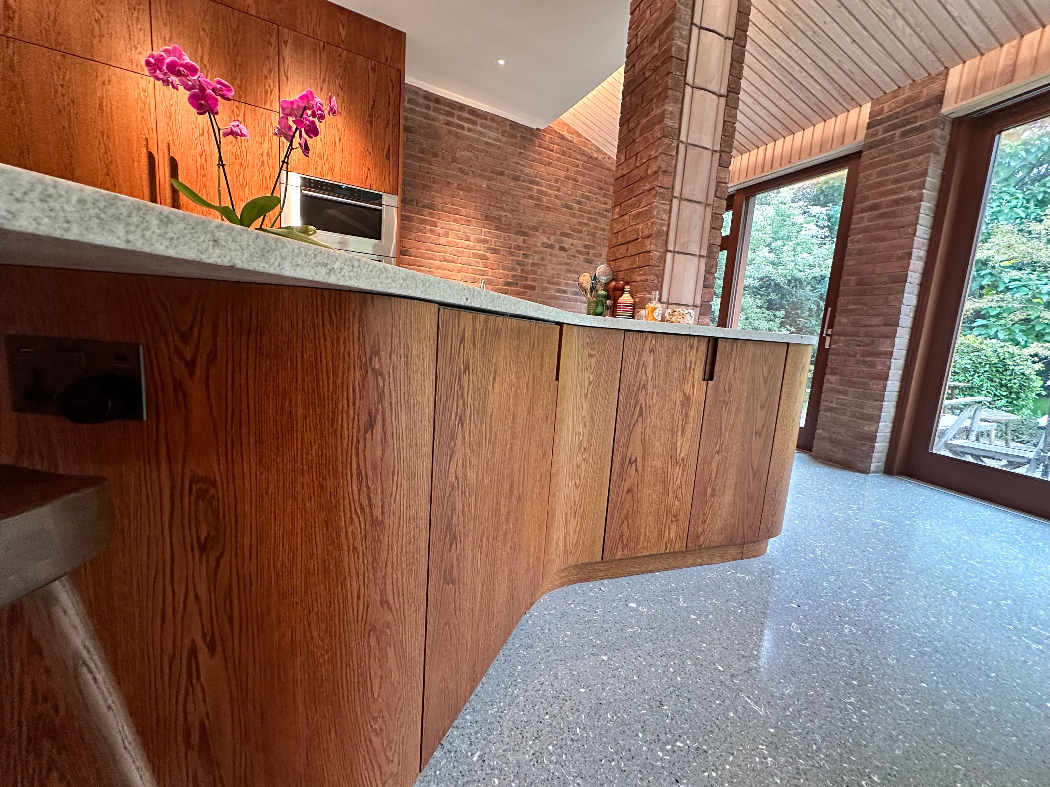

Bespoke Furniture
BUSINESS PRESENTATION
1

Slide 2
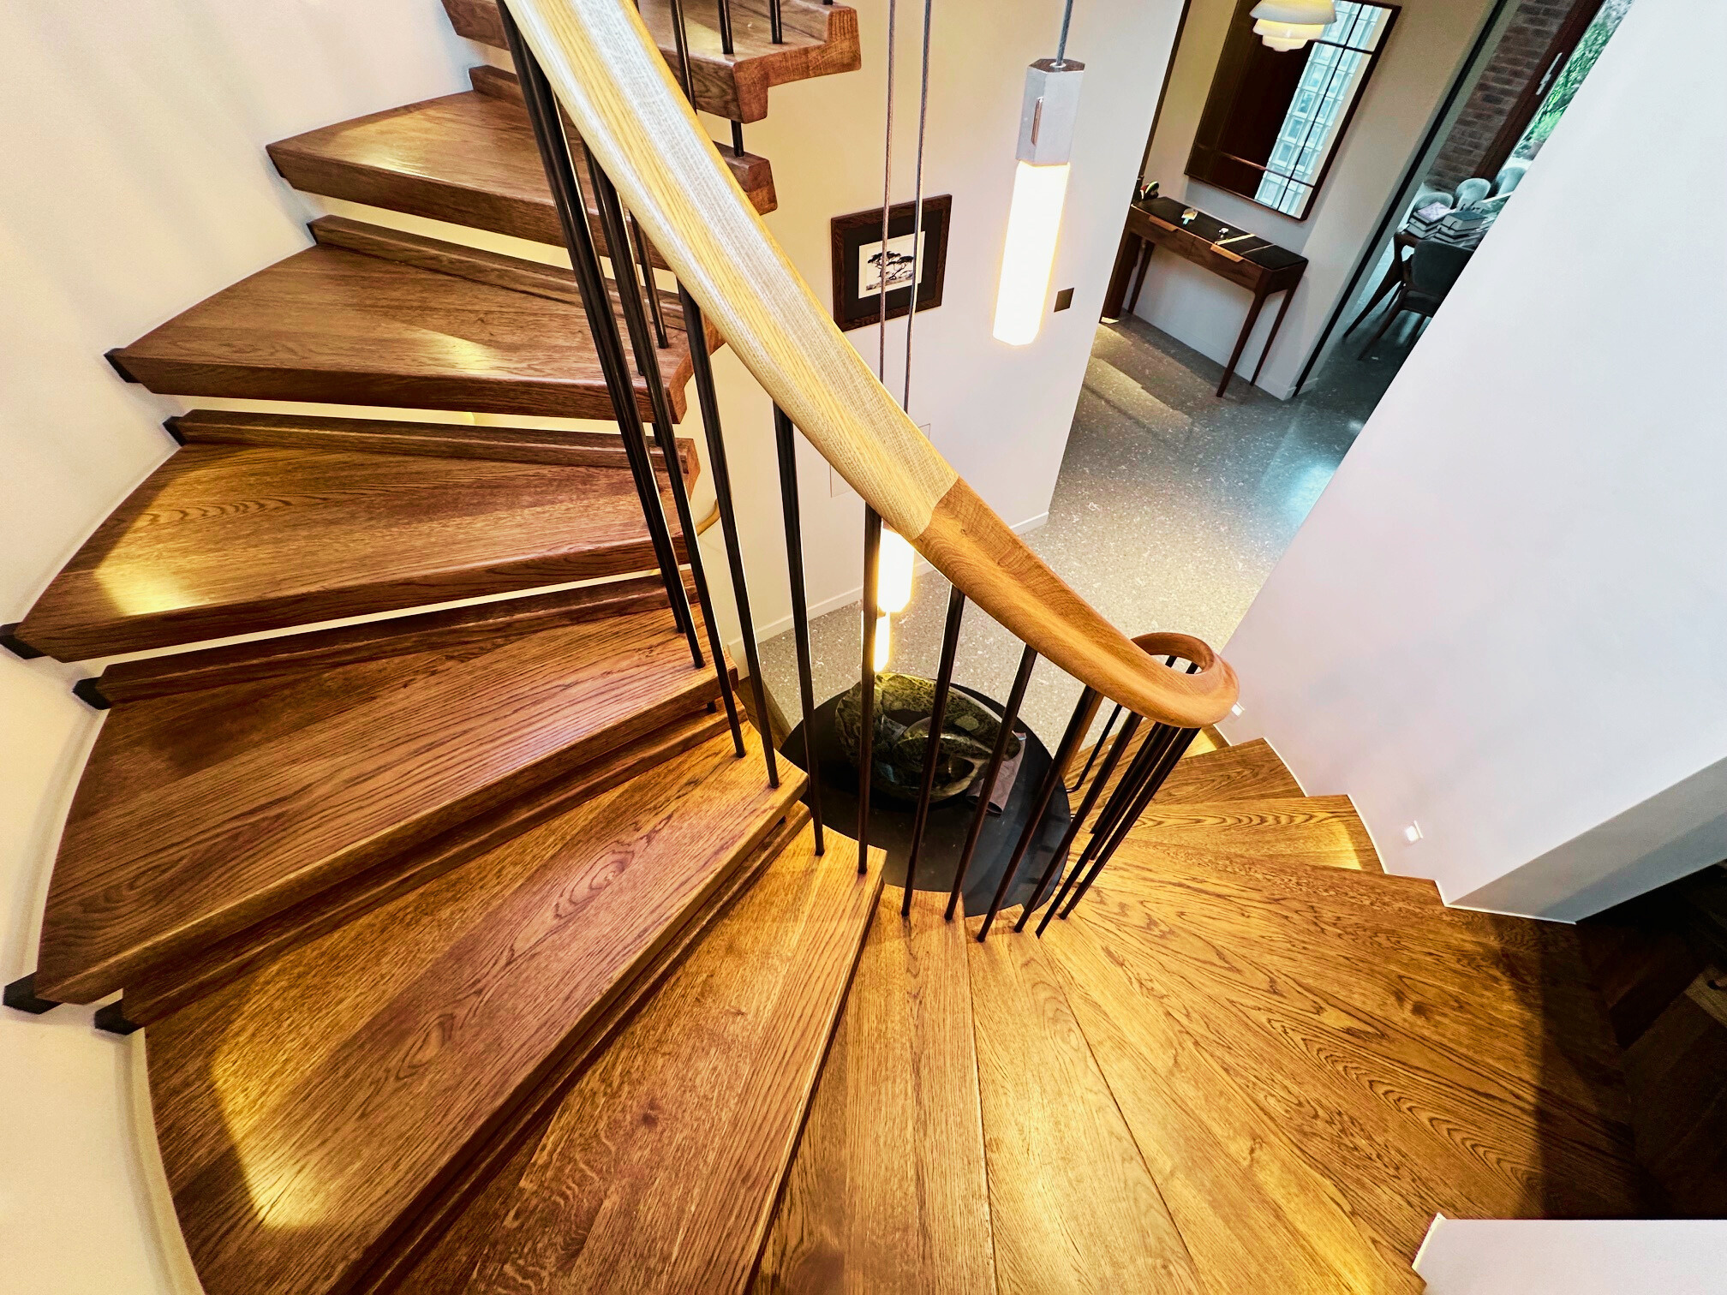
A﻿BOUT US
We are a company operating in the furniture industry. We develop products with local craftsmen who demonstrate high quality and creativity. Our range includes various types of furniture crafted from different materials. Each piece is individually designed to complement the style of the client’s home and tailored to specific requirements.
2

Slide 3
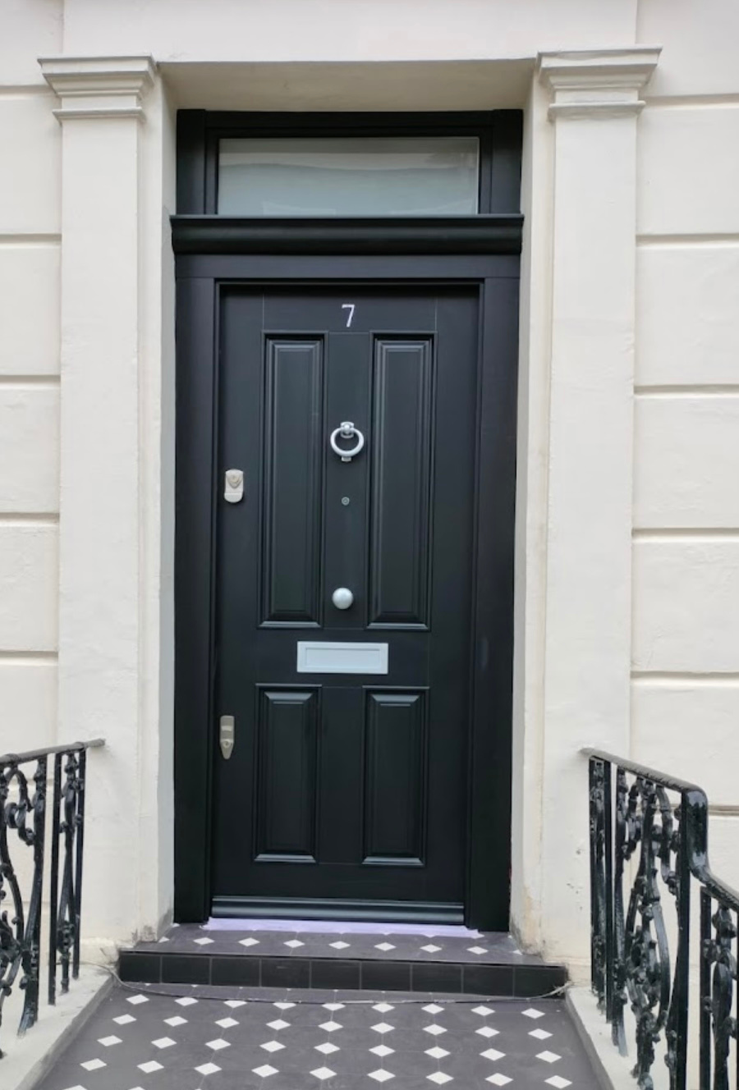
OUR SERVICE
DOMESTIC AND COMMERCIAL
bespoke wardrobe and cupboard
build in kitchen
bathroom cabinet
shelving
TV unit
doors
staircase
And many more
3

Slide 4
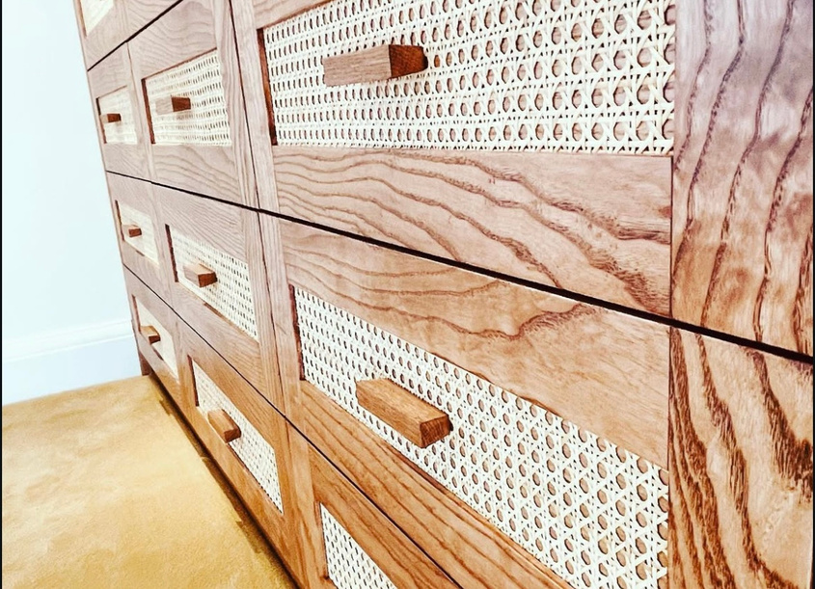
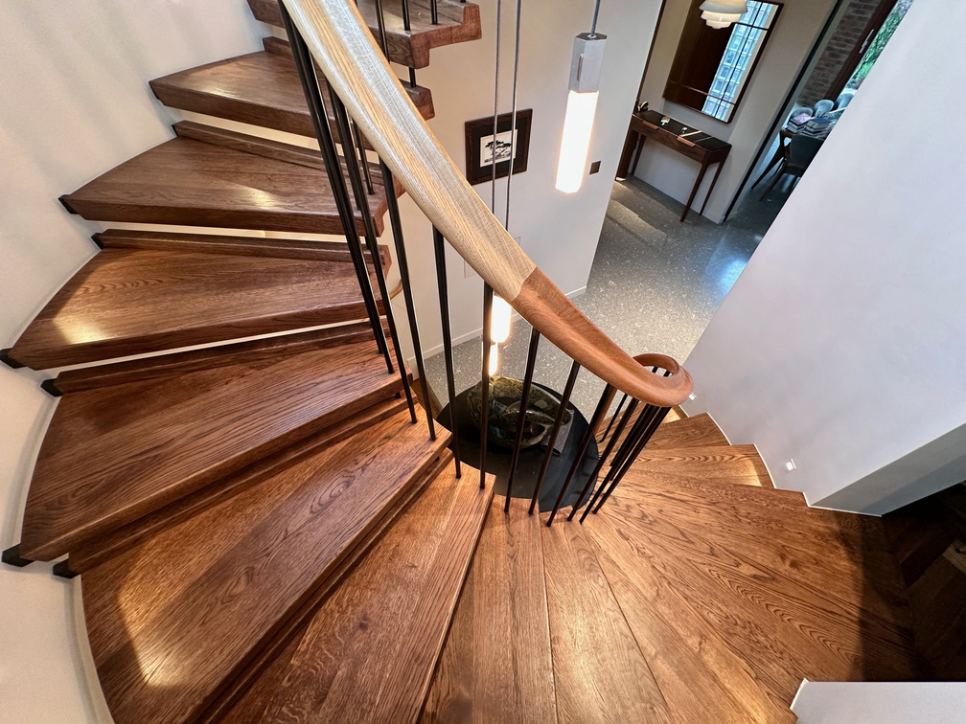
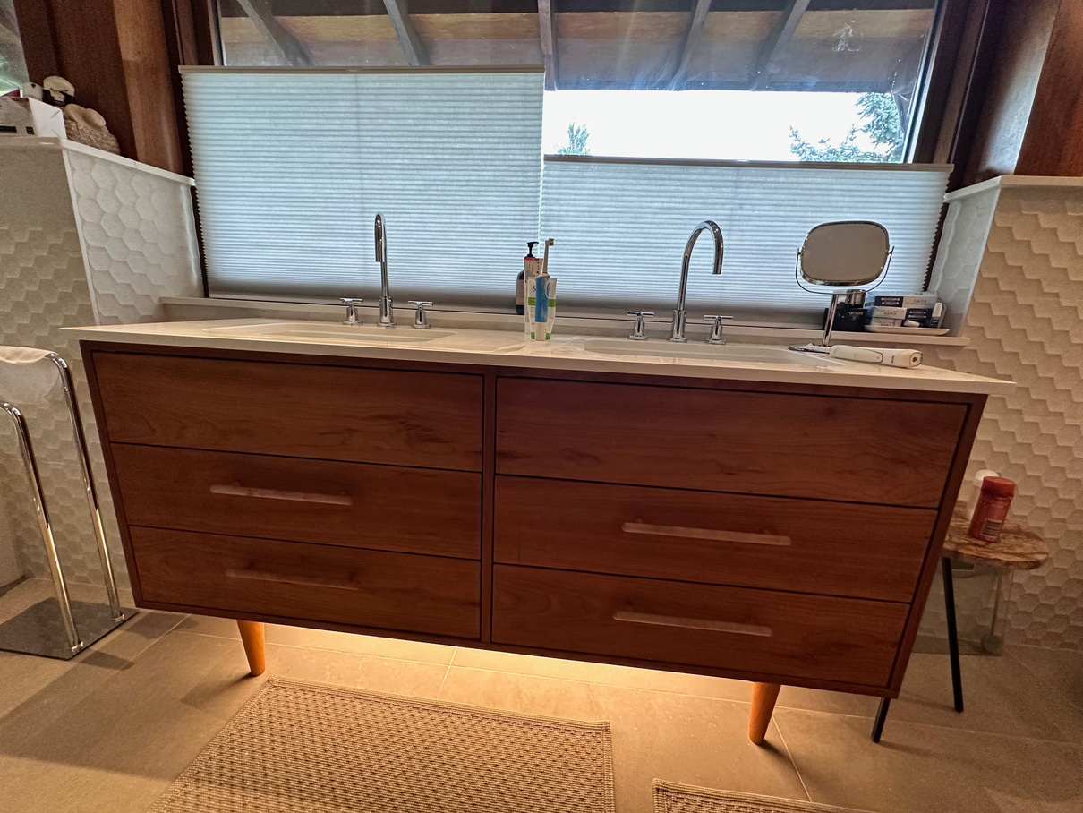
OUR CRAFTMANSHIP
4

Slide 5
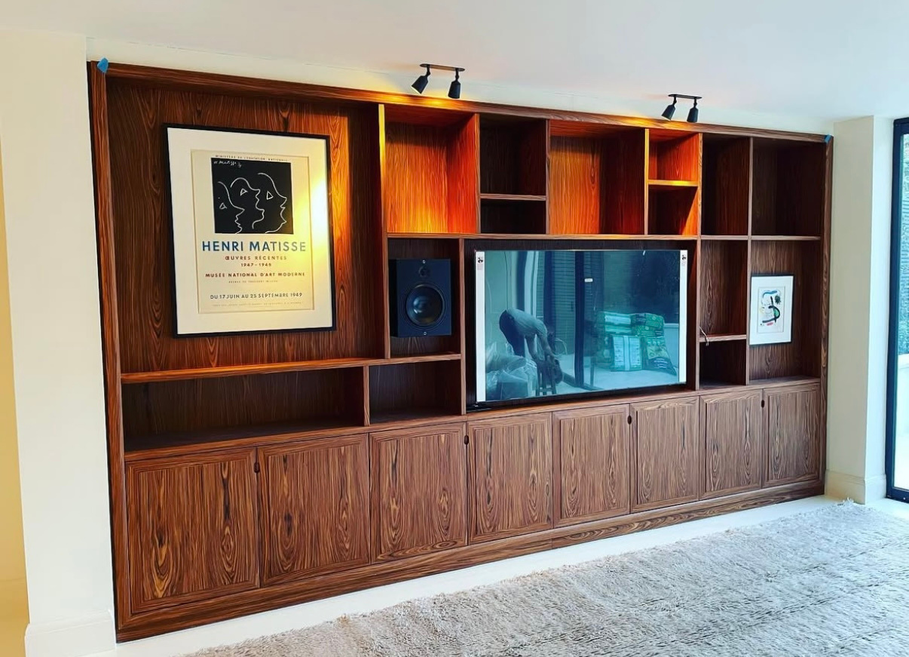
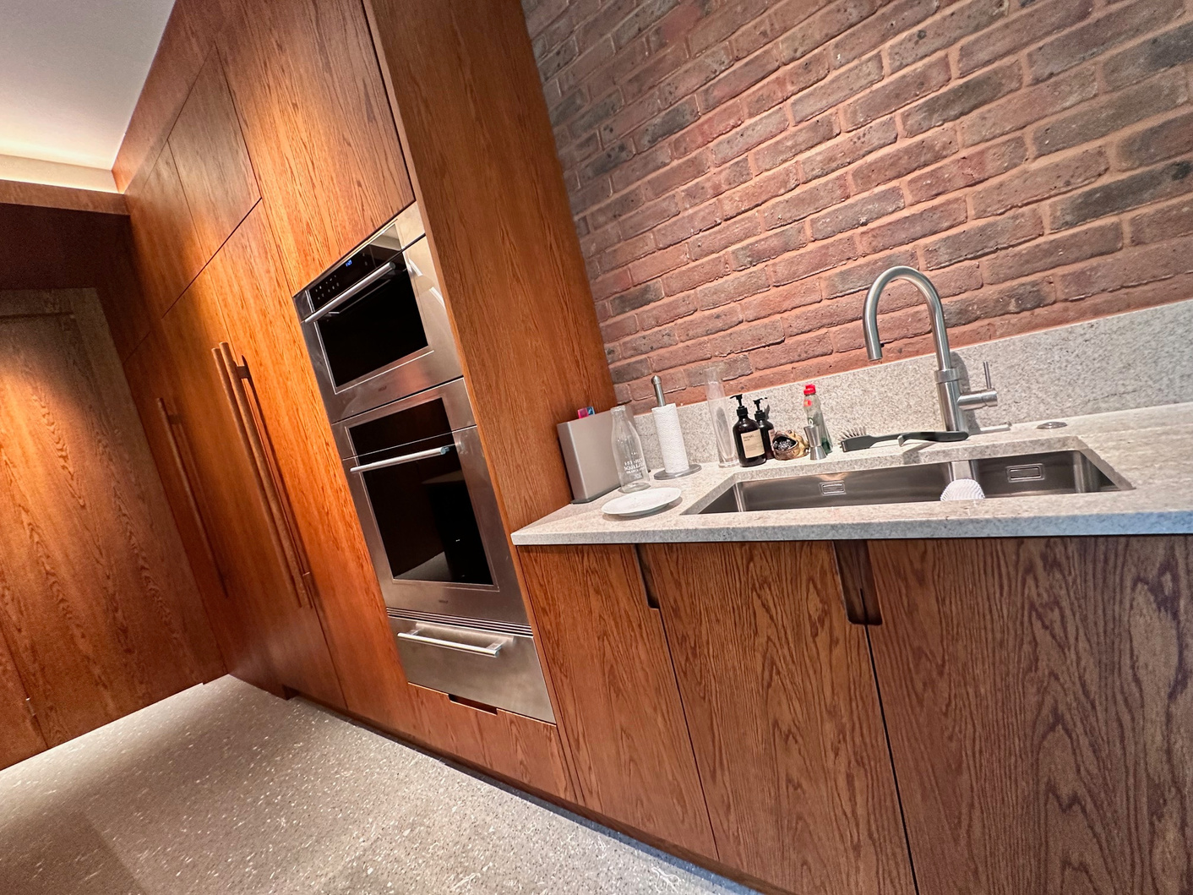
QUALITY BUILDS
5

Slide 6
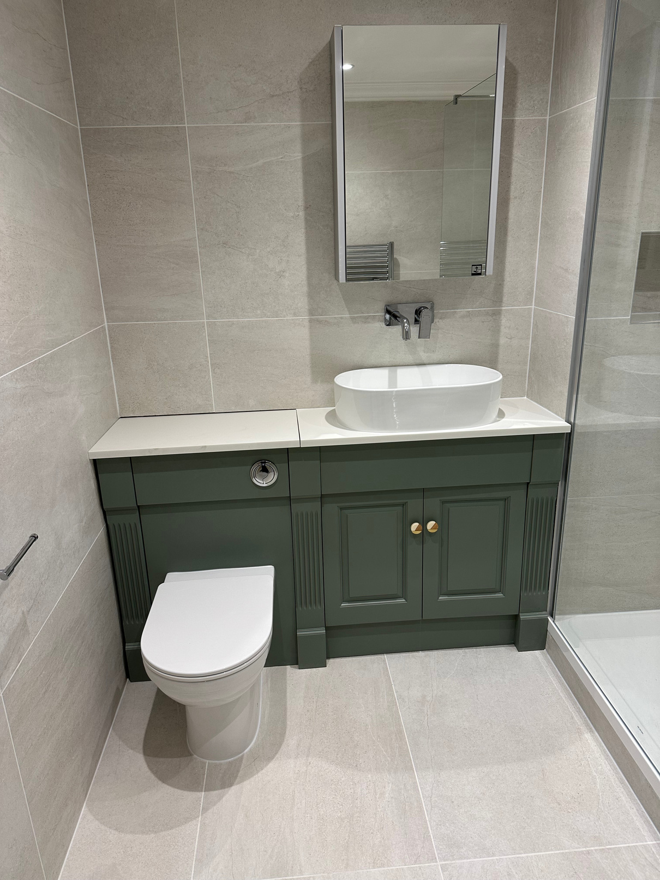
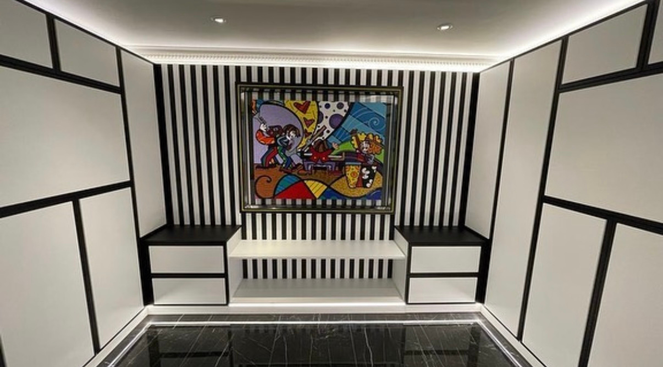
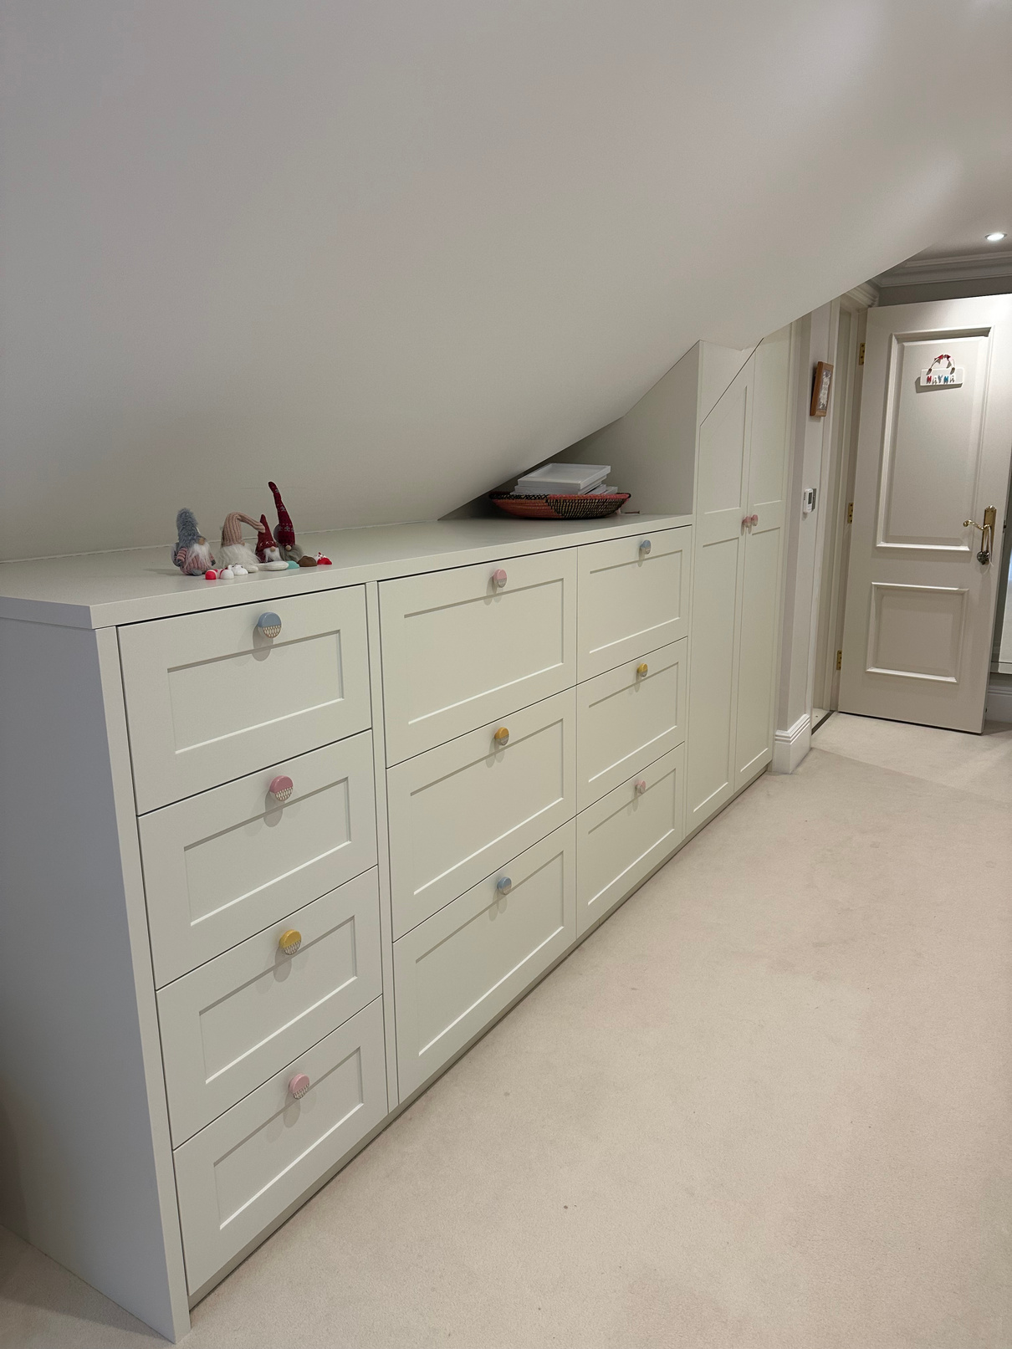
ELEGANT DESIGNS
6

Slide 7
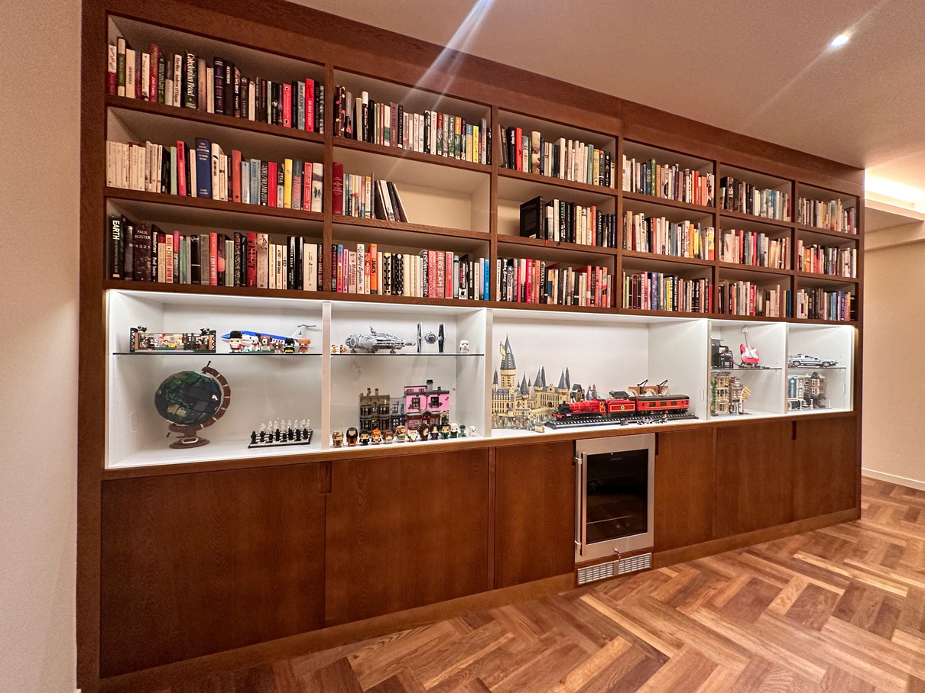
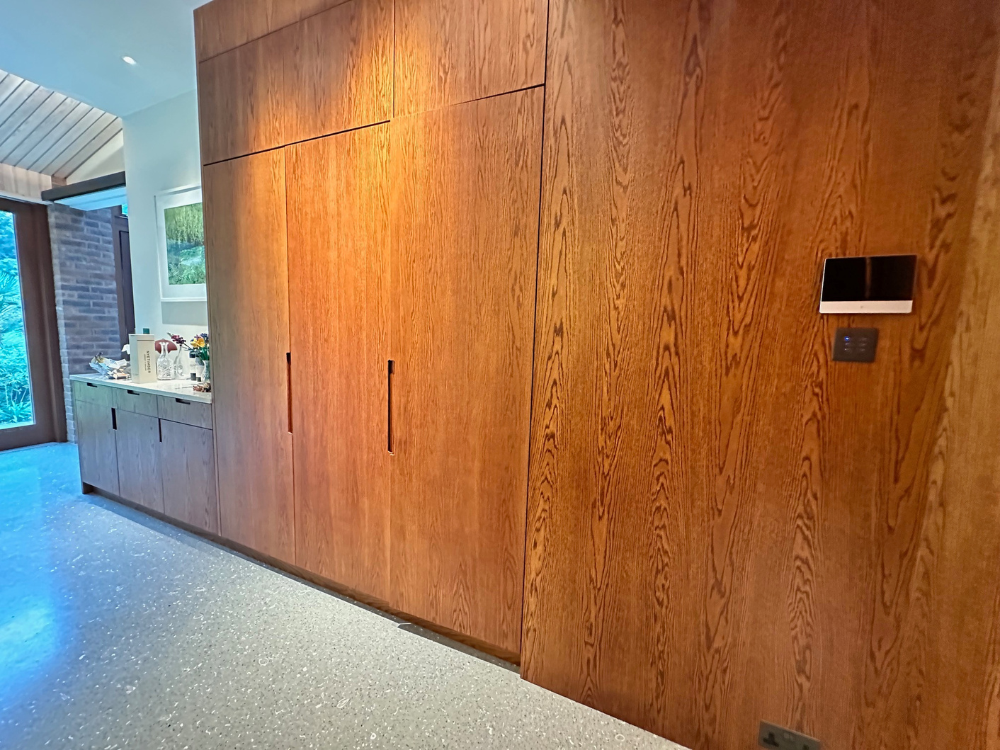
TAILORED SOLUTIONS
7

Slide 8
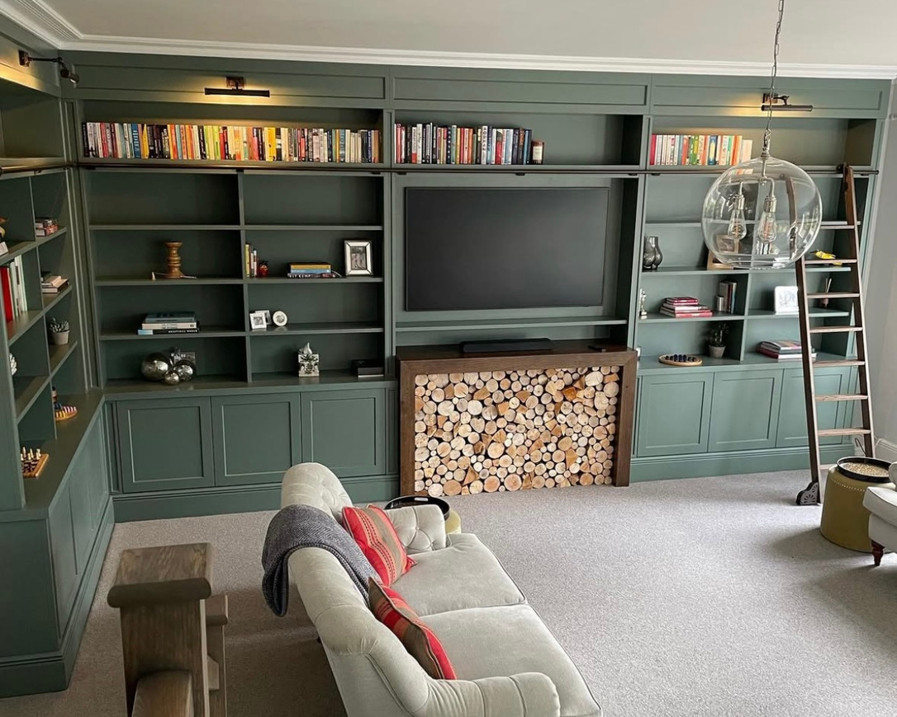
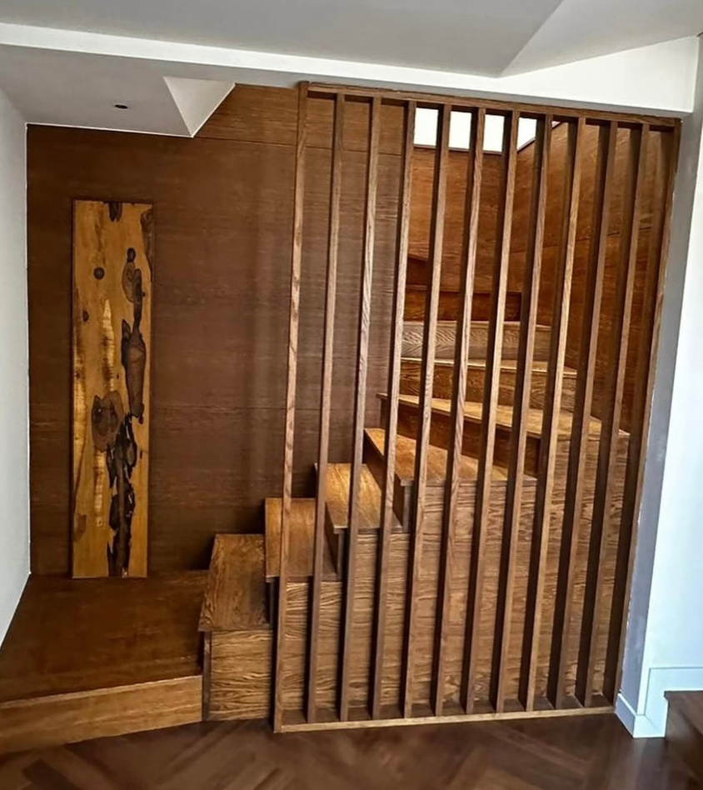
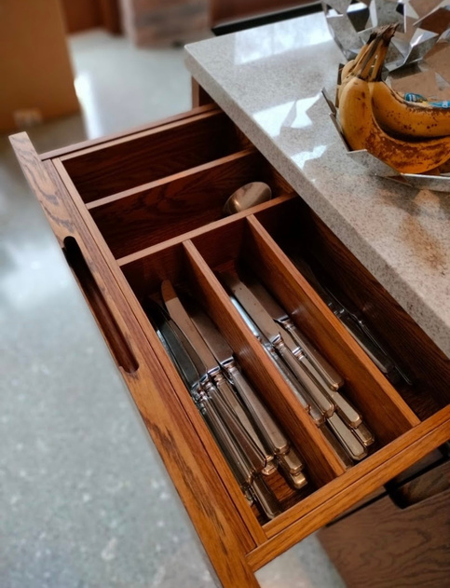
CRAFTED WITH CARE
8

Slide 9
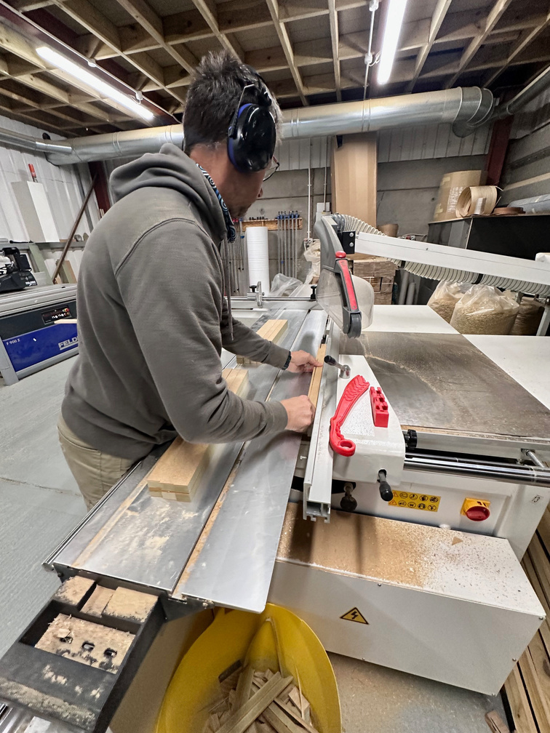
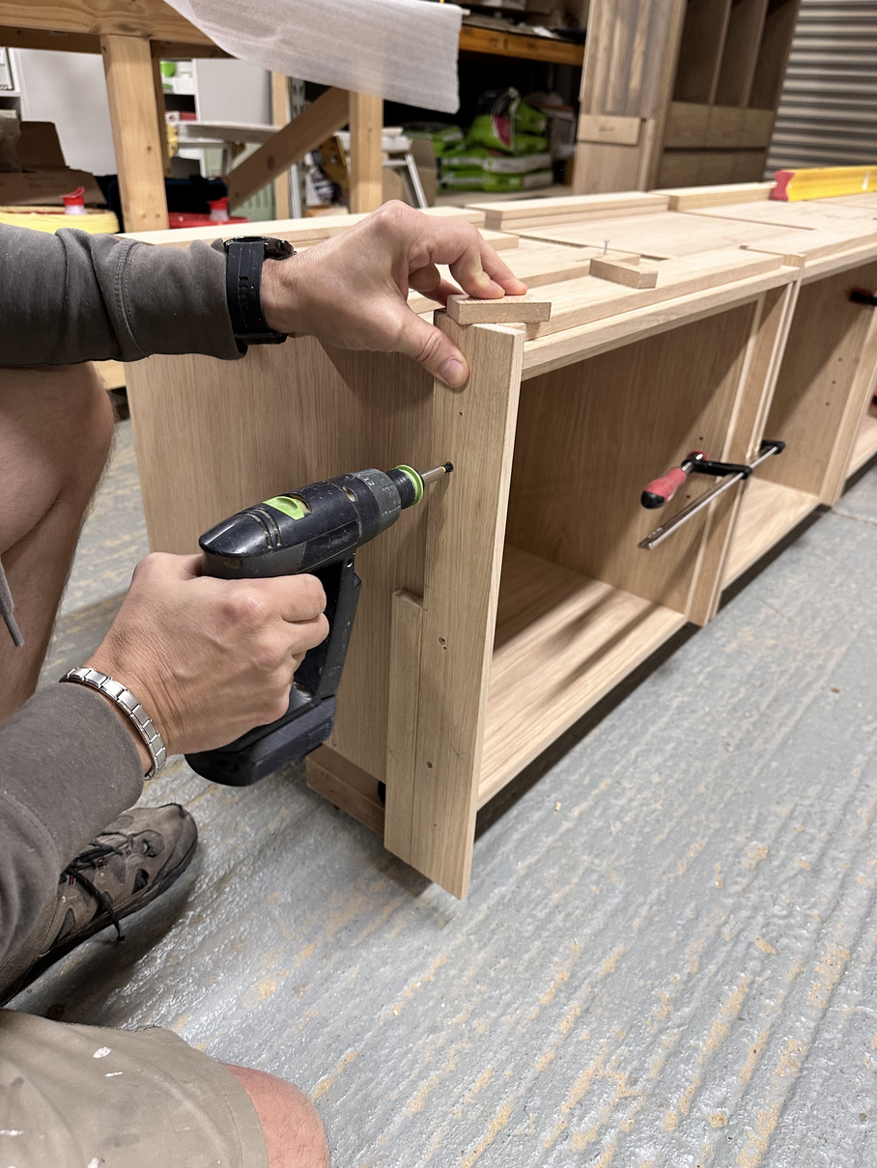
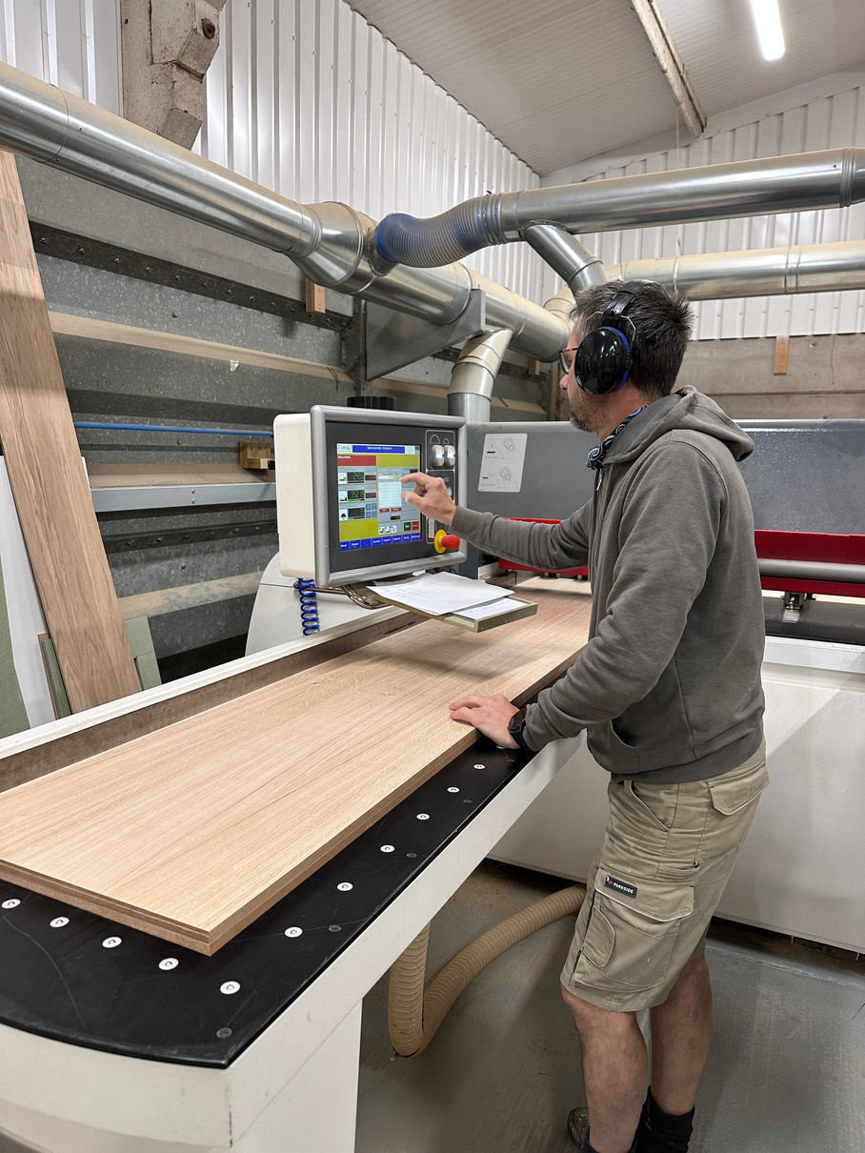
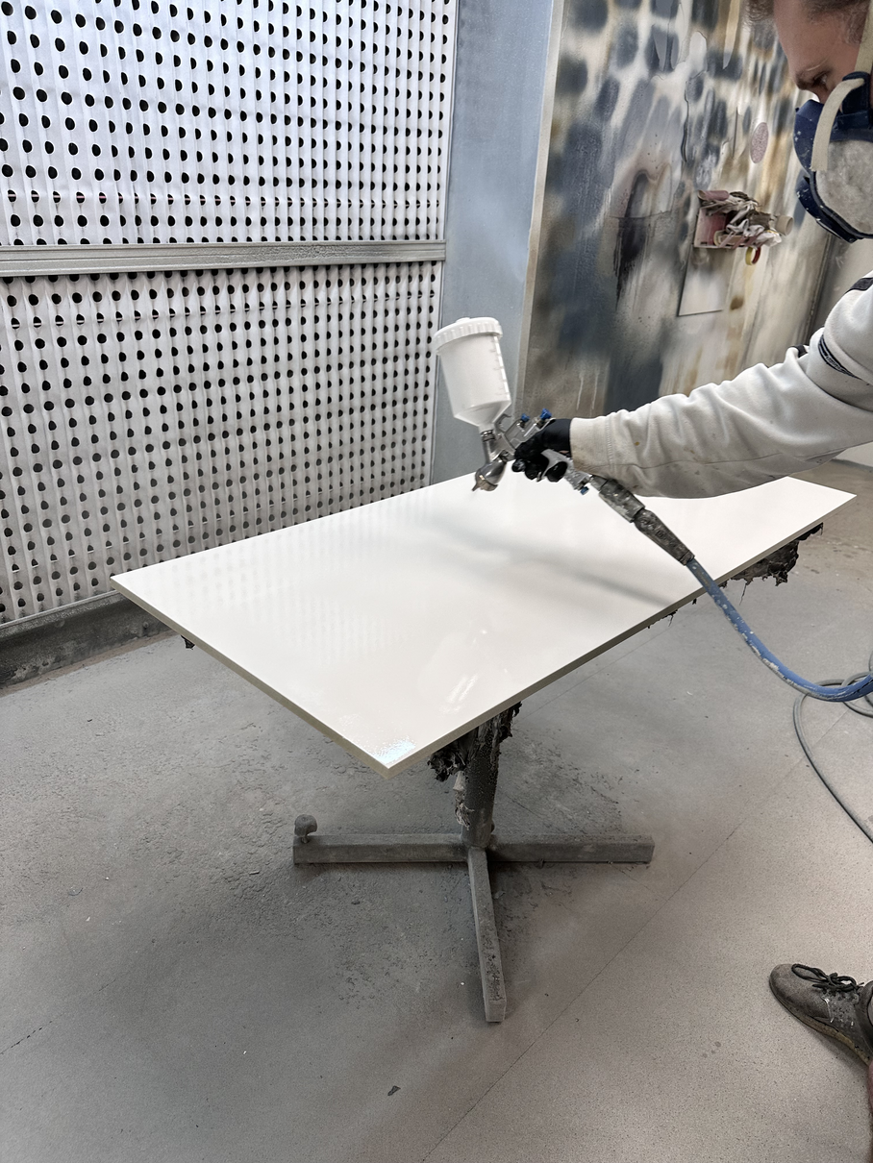
OUR WORKSHOP
The company’s workshop is located at Whitchurch Business Park, Aylesbury
9

Slide 10

WHY BODEN FURNITURE?
  Timeless Quality: Durable furniture built to last.
  Exceptional Craftsmanship: Handcrafted with meticulous attention to detail.
  Sustainable Materials: Eco-friendly sourcing practices.
  Personalized Service: Expert guidance to find your perfect style.
  Competitive Pricing: Affordable elegance without compromising quality.
  Comfort and Style: Designs that enhance both aesthetics and comfort.
10

Slide 11
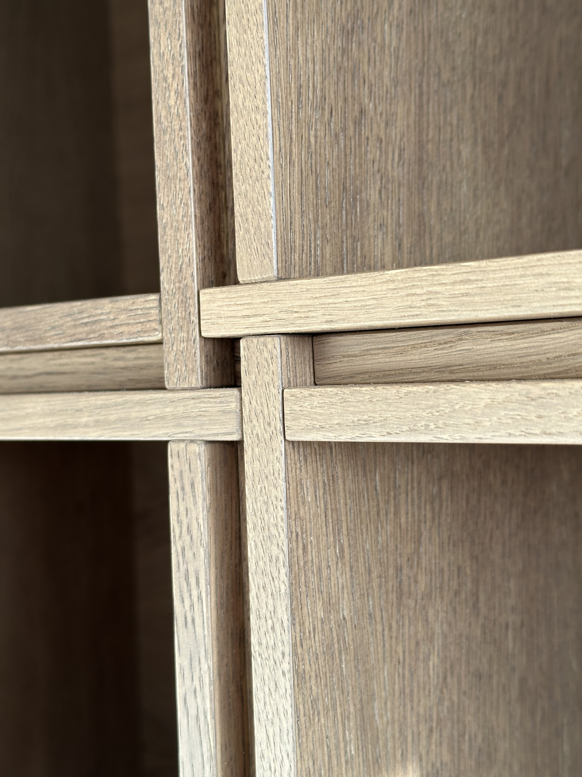


CONTACT US!
And Enjoy Your New Furniture
Unit 7, Whitchurch Business Park, Manor Farm, Buckingham Road, Whitchurch, Aylesbury, HP22 4RB.
07792385224
info@bodenfurniture.com
boden_furniture
11

